Slide 1
United States Coast Guard Vessel Identification System – VIS
NASBLA E-Learning Module

Slide 2
Module Outline
System Introduction
Background
Frequently asked questions
List of Participating States
Getting Started
Access
Login
System Interface
Conducting Vessel Searches
VIS Vessel Search
VIS Documentation Search
VIS Stolen Vessel Search

Slide 3
1 - System Introduction
A. Background
In 1988, Congress passed legislation that required the United States Coast Guard to develop a vessel identification system (VIS) to share individual states’ vessel information as well as information on federally documented vessels. With such a system, the Coast Guard, state law enforcement officials, and state registration and titling officials, could more effectively identify information on vessels in our nation’s ports and waterways, the need for which has heightened since the September 11 terrorist attacks.

Slide 4
Most large commercial vessels and many large recreational vessels obtain federal documentation; smaller vessels are registered only in the state where they are principally operated. A vessel identification system would allow the Coast Guard, local law enforcement officials, and registration and titling agencies to more effectively identify critical information on small vessels; information including the owner’s name, vessel identification, and any prior law enforcement activities associated with the vessel. Other information was to include information on any liens associated with the vessel, and information to assist law enforcement officials, such as the date a vessel was stolen or abandoned.

Slide 5
The Coast Guard’s early efforts to acquire VIS were unsuccessful. In the late 1980’s and early 1990’s, the Coast Guard undertook numerous activities to define requirements for such a system. In 1995, the agency contracted to develop the Marine Information for Safety and Law Enforcement (MISLE) system, of which VIS was a subcomponent. The Coast Guard accepted the contractor developed VIS in 1998 despite system performance problems, intending to resolve these problems as the system evolved. However, the Coast Guard later found no viable way to correct these and other problems. Despite the $9 million in identified costs to plan and develop VIS, it was never implemented.

Slide 6
In 2002 the General Accounting Office did a review of the VIS project and recommended that the Coast Guard consider other implementation alternatives, including working with a commercial vendor. The Coast Guard, along with at least one independent contractor, further evaluated its alternatives and decided in mid-2006 to solicit bids from several commercial vendors including Info-Link. The Coast Guard selected Info-Link in 2006 to collect the data needed for VIS.

Slide 7
B. Frequently Asked Questions
What is the Vessel Identification Systems (VIS)? VIS is the Vessel Identification System. The data for VIS consists of registration and ownership data from participating VIS States and USCG National Vessel Documentation Center. VIS data will only be accessible to registration personnel and law enforcement personnel of VIS participating States and Federal Agencies.
What are the benefits of participating in VIS? States who participate in VIS will have access to boat registration and ownership data from other States and USCG Documented vessels in a single database. Access to this data will help identify vessel ownership history, State registered vessels that change registration to other States, and changes in law enforcement status for vessels.

Slide 8
How much will VIS participation cost? There are no fees or payments required to participate in VIS, however participating States must bear any costs related to extracting data from their information system and transmitting that data to the Coast Guard or its designee. Participating States must also provide their own computer equipment and data connections necessary to access the web based VIS.
Does VIS participation prevent my State from charging the VIS contractor for vessel data? Per the upcoming VIS Memorandum of Agreement between the USCG and States. States cannot charge the USCG to provide data for the sole use in VIS. If the state allows the data to be used beyond the sole use of VIS (commercial purposes), then your State can charge VIS contractor the same amount they would charge other commercial vendors for the same data.

Slide 9
How is VIS different from NCIC and NLETS? NLETS provides law enforcement personnel access to law enforcement data from other State and Federal law enforcement data in the NCIC. Some States make boat registration data available via NLETS; however state participation is limited. CG Documented vessel ownership information is not currently available via NLETS, although some vessel descriptive information is available from CGMIX. Because NLETS is limited to law enforcement personnel, State registration and titling personnel do not have access to that system. VIS will contain vessel descriptive information and ownership data for CG Documented vessels and participating States numbered vessels. This provides a single database to look for ownership information even if the state of registration is unknown. State registration and titling personnel will have access to VIS and VIS data will be available to law enforcement personnel from participating States via NLETS.

Slide 10
Can my State participate in VIS if my State boating registration system does not collect all the data elements required under 33 C.F.R. 187? Yes, the USCG understands some State systems do not capture all data elements required under 33 C.F.R. 187 for participation in VIS and has initiated a regulatory change proposal which will give the Commandant authority to grant VIS participation waivers to States whose registration systems do not collect all data elements required under 33 C.F.R. 187. However, waivers will not be granted automatically. Waivers shall be granted only when sufficient data elements are provided to meet the minimum needs of VIS and the Commandant determines a waiver is in the best interest of the system. States who need a waiver before the regulatory language is changed may sign the MOA and will be granted access to VIS but the State will not be not be listed as a “participating state” until the regulatory amendment granting case-by-case waiver authority is completed.

Slide 11
Do we need to modify our State registration database to capture the data elements required under 33 C.F.R. 187? No. States are not mandated to modify their current systems to participate in VIS if they can provide sufficient data elements to meet the needs of the system. VIS will accept data elements from your system in your current format and to the extent they are available in your database. The Coast Guard or its designee is responsible for transforming State data into a consistent VIS format so that all States can reap the benefit of the data. The Coast Guard encourages States whose systems do not currently capture all data elements listed under 33 C.F.R. 187 to upgrade their system to capture those data elements at the next available opportunity. States that apply for State Titling Certification under 33 C.F.R. 187.301 will not be granted waivers from the data element requirements.

Slide 12
What are the data uses and privacy restrictions of VIS data? VIS data use will be restricted in accordance with State and Federal laws. Primary use of VIS data is for state numbering and titling, law enforcement and homeland security purposes. States must determine whether they want to restrict use of their data to only VIS use or whether data elements may be used by the Coast Guard designee for other purposes in accordance with State law. If States allow other uses of their data, they must establish a separate agreement with the Coast Guard designee.

Slide 13
Why is there a disclaimer regarding "restricted to VIS use only" in the MOA if VIS data is only used for State Numbering and Law Enforcement? Many States currently provide data to commercial vendors for marketing and other purposes not related to VIS. The VIS contract does not void or supersede current agreements between the States and those commercial vendors. Doing so would adversely impact the business of the Coast Guard VIS contractor who collects and sells data in the course of its business. The disclaimer assures States who provide the additional VIS data elements that would otherwise not be provided to a commercial vendor because of privacy laws that they can designate those elements as ”FOR VIS USE ONLY” and thereby restrict the VIS contractor from using those data elements for any purpose other than VIS.
Who should I contact with questions about VIS? Questions about VIS should be sent to ervin.d.boyd@uscg.mil

Slide 14
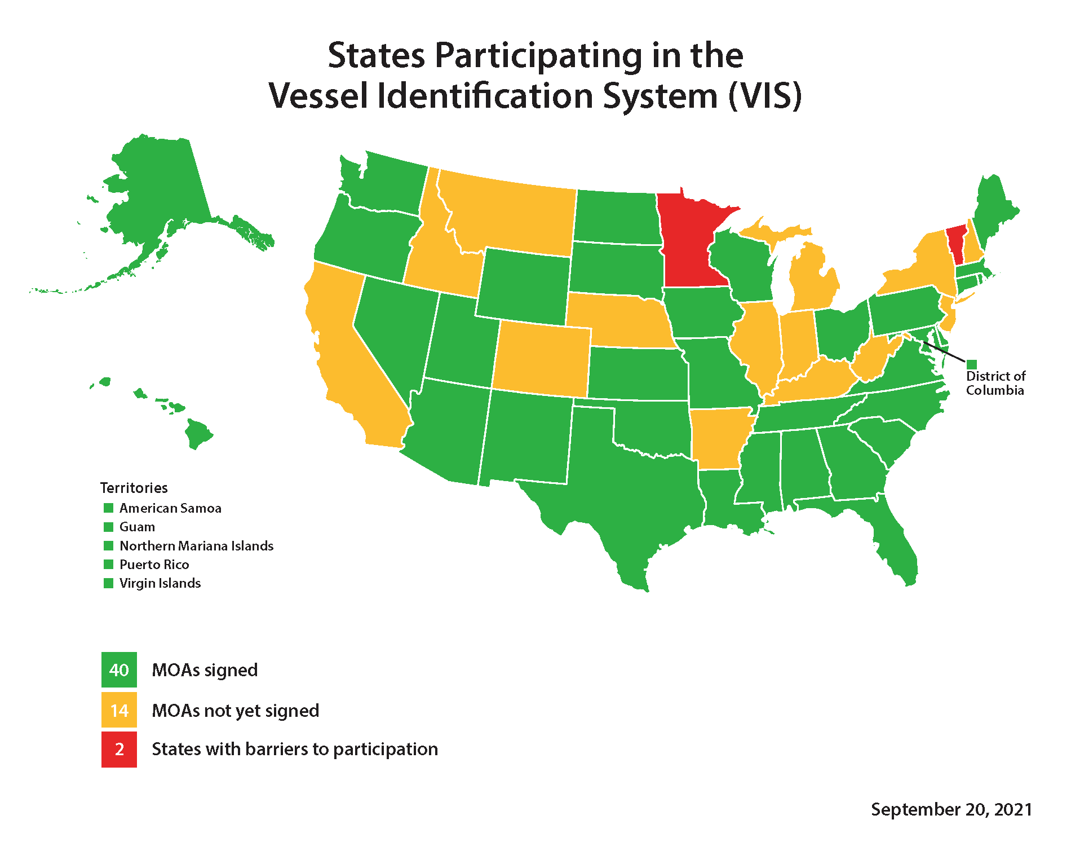
C. Map of Participating States

Slide 15
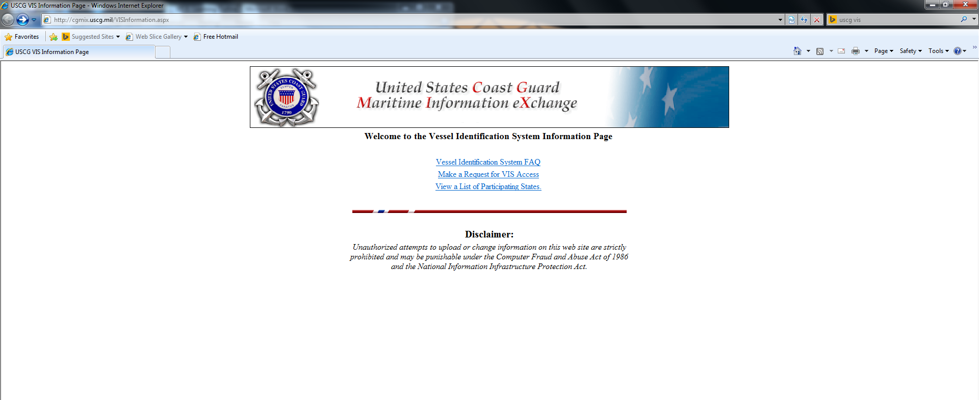
2 – Getting Started
A. Access
Access to the USCG VIS system is through any common web browser. The Vessel Identification System Information Page can be found at http://cgmix.uscg.mil/VISInformation.aspx or by searching USCG VIS using common web search pages.
From the VIS Information Page, select Make a Request for VIS Access

Slide 16
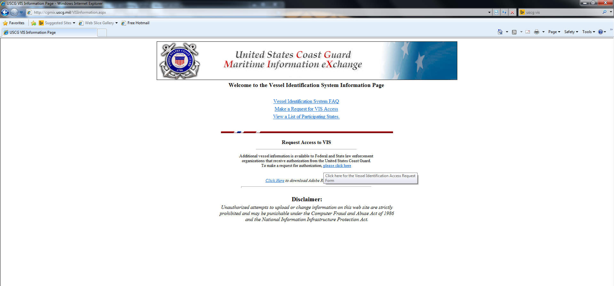
A Request Access to VIS dialog section will appear. Select, please click here
A PDF screen should appear with the form titled - United States Coast Guard Vessel Identification System User Request Form. If not, Adobe Reader can be downloaded for free from the VIS Information page.

Slide 17
Complete the form, print, and add signature.
Email the completed form to ervin.d.boyd@uscg.mil

Slide 18
B. Login
Login information will be sent to the applicant’s supplied email address after the application is processed. The URL for the VIS system is: https://cgvis.uscg.mil/logon.aspx?ReturnUrl=%2fdefault.aspx
Save this web address to your favorites or create a shortcut on desktop.
Upon navigation to the VIS Login page a Message from webpage window will appear.
You must read the message and agree to the terms by selecting OK.

Slide 19
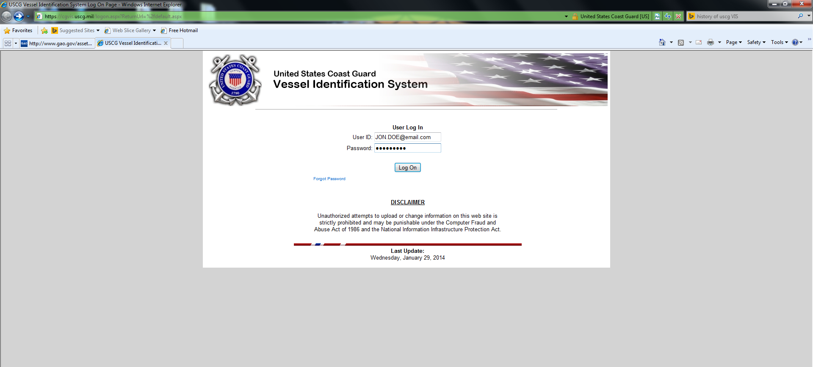
After selecting OK, navigation to the USCG VIS login page is continued.
Enter User ID (email address) and assigned password.

Slide 20
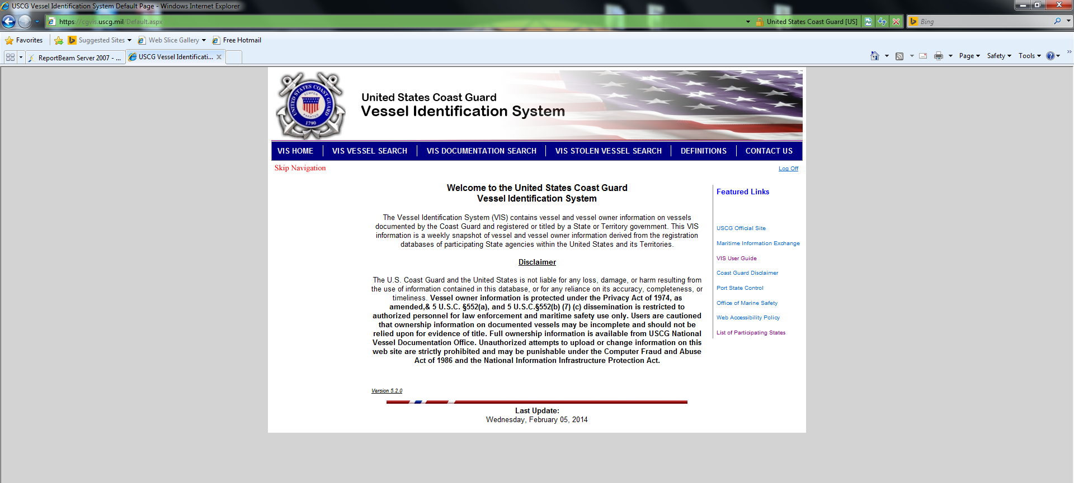
VIS Home Page
From the VIS home page vessel searches can be made in three main categories; vessel search, documentation search, and stolen vessel search. Other useful information such as definitions, USCG VIS User Guide, and common USCG web page links are available from the home page as well.

Slide 21
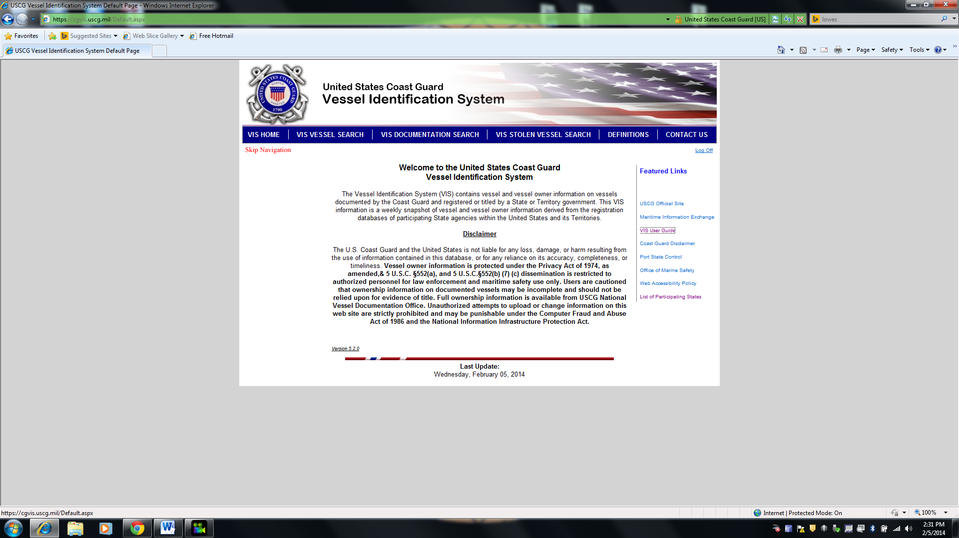
C. System Interface
VIS Vessel Search – Search by owner, business, vessel name, state, HIN, reg. #, and year.
VIS Documentation Search – search all registrations in set parameter of days.
VIS User Guide
VIS Stolen Vessel Search - VIS Stolen Vessel Data is based on notifications sent to the USCG by the National Crime Information Center (NCIC). The capability to search VIS NCIC notifications began June of 2012.

Slide 22
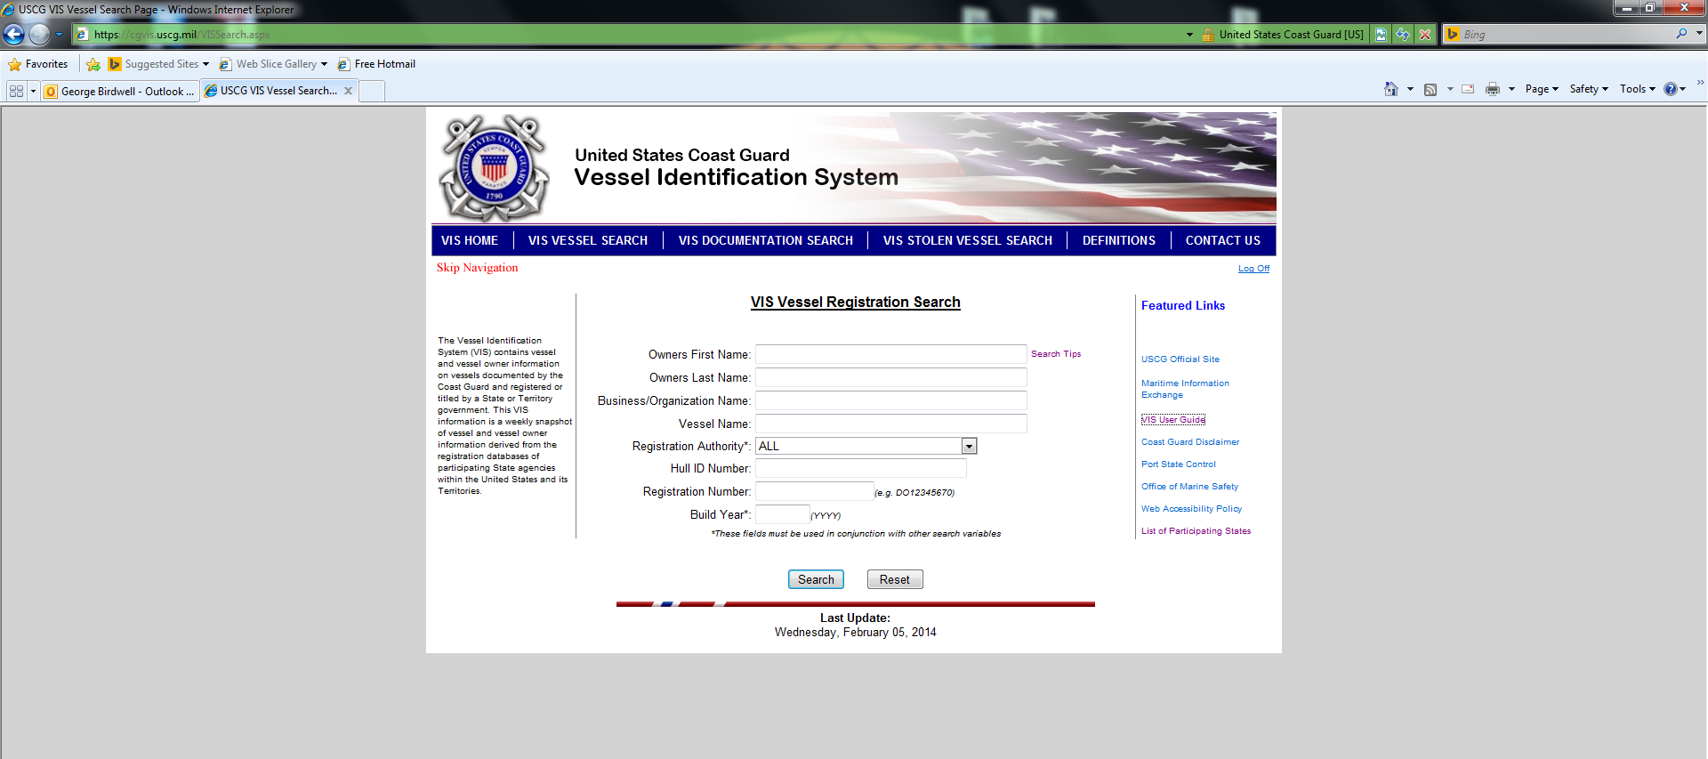
3 - Conducting Vessel Searches
A. VIS Vessel Search
As described in the previous section, vessels can be searched by various fields. Input known information in the appropriate fields. Two fields, registration authority and build year, requires at least one other search variable to be entered.

Slide 23
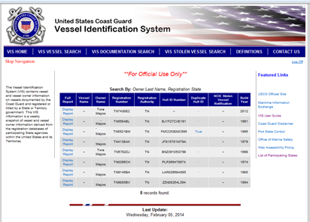
The following example of a search by last name and registration authority yields 8 records.

Slide 24
When searching, using more search criteria will restrict the search and the results will be narrowed, possibly only showing the desired record. In the following search, a first name was added to the previous example resulting in 2 records.
Wildcard Characters:
Wildcard characters are automatically added to vessel name searches. However, if you wish to further refine your search you may use two wildcard characters. The underscore '_' character replaces a single character. Example: J_pan searches for Japan, Jbpan, Jcpan and so on. The percent '%' character can be used to replace any combination of characters. Example: Ja% would return both Japan and Jacksonville.

Slide 25
Once the appropriate record is found, vessel information may be viewed by selecting Display Report on the records found page. Owner, vessel, law enforcement, lien and title, and historical information tabs are selectable at this point. Reports can be printed from any tab.
Only vessel information that has been submitted by the states’ registration authority will be displayed. Because each state will have different privacy standards, laws, and/or regulations, search result data will differ from state to state.

Slide 26
B. VIS Documentation Search
The VIS Documentation Search page is used when searching for recently registered vessels within a specific state or recently documented vessels with the USCG.
From the Documentation Search page select either specific state or Coast Guard documentation by selecting either Click here option.
From the State Registration Search page select the appropriate state.
Next, select the time parameter of the search to be performed; 30, 60, or 90 days.

Slide 27
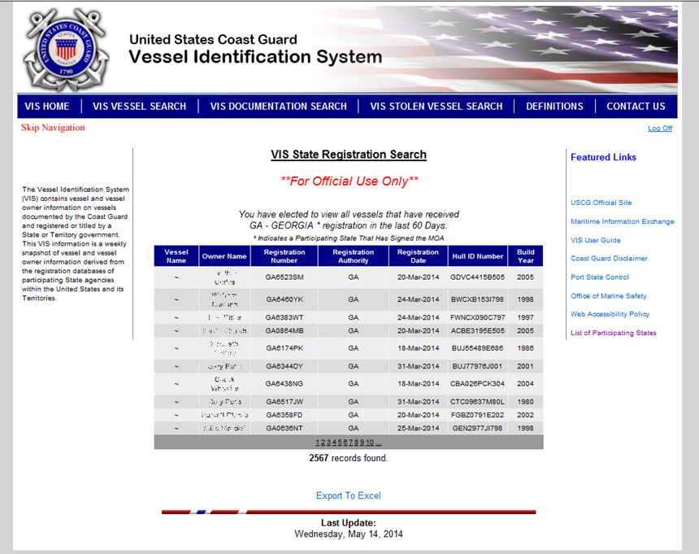
It is likely that a high number of results will be found. From the results page, the data can be exported to an Excel spreadsheet for further analysis by using the Export To Excel tab.

Slide 28
C. VIS Stolen Vessel Search
VIS Stolen Vessel Data is based on notifications sent to the USCG by the National Crime Information Center (NCIC). The capability to search VIS for NCIC notifications began June of 2012. The USCG Notification Date Range fields will automatically default to one year; however the data reported will only reflect notifications received after June 2012.
From the VIS Stolen Vessel Search page, enter either vessel registration number or the vessel Hull Identification Number.

Slide 29
If a stolen report is found, select view notification box to the right of the record.
To view and/or print the record, select Click here for a report on all checked notifications.

Slide 30
Print record option.
If a search with VIS returns a record of a stolen vessel, a Hit on NCIC does not occur. The originating agency does not receive any notification and no response is needed.
A positive response from VIS/ NCIC is not probable cause for an officer to take action. NCIC policy requires the inquiring agency to make contact with the entering agency to verify the information is accurate and up-to-date. Once the record is confirmed, the inquiring agency may take action to arrest a fugitive and/or recover stolen property.

Slide 31
A NASBLA VIRT Committee Project
NASBLA VIRT Committee – NASBLA’s Vessel Identification, Registration & Titling Committee (VIRT) recognizes that accurate vessel information is the backbone of recreational boating safety data. The VIRT Committee works to advance boating safety by analyzing and advocating for thorough and precise vessel identification throughout a vessel's chain of ownership from the hull numbering to registration to titling.
NASBLA VIS Subcommittee - The Vessel Identification System (VIS) Coordination & Implementation Subcommittee works to assist the Coast Guard on development and implementation of the Vessel Identification System. The subcommittee also works to provide guidance resources such as the preceding module for states as they join and implement the Vessel Identification System.

