Slide 1
How to Navigate BoatBeat–NASBLA- 2017
Scenario to Aid Learning How to “navigate “ and get the biggest benefit out of BoatBeat for PIO’s
Notes:
Welcome and Introductions

Slide 2
Goals of this Presentation
Provide an understanding on how to take full advantage of the BoatBeat website
Receive input on how to improve the website

Slide 3
Goals of the Media Toolbox
Resources for PIOs and the Media
PHOTO Fact Sheets
Links to factual and educational websites
Subject matter
Subject Matter Expert Resources
State and National organizations, contacts, links
Access to trending news topics with Media Alerts

Slide 4
What do Reporters Want?
The full story
Accurate facts and details
To interview key players
Succinct Messages
Fast Results
Notes:
The full story
Reporters are looking to get both sides of the story so be aware of this.
Accurate facts and details
If you don’t know something, it’s ok to say, “I don’t know. I will get back to you once I find out.”
To interview key players
Reporters want to interview key players. This is why we have provided a PIO contact list
Succinct Messages
Remember that reporters have very limited time and if you can give them an answer in a concise, quick manner, you will be more successful
Fast Results
Be conscious of reporters strict deadlines

Slide 5
Boating Accident Reporting: Do’s and Don’ts
DO
Know what can be discussed
Know what cannot be discussed
Share safety and education
Answer questions, not statements
Answer with knowledge and facts
DON’T
Share specifics of accident date currently under investigation
Get wrapped up in messages that do not relate to your organization’s goal
Be afraid to say, “I don’t know, but I’ll find out”
Answer with emotion
Be intimidated by silence
Notes:
DO
Know what can be discussed
Causes and trends
Know what cannot be discussed
Details, active investigations, names, details about minor age victims
Share safety and education information
fact sheet content specific to the type of accident, but, generic, without blame about the accident at hand
Answer questions, not statements
Reporters will often try to trick you and make you respond to a statement. It is ok and encouraged to say, “Was that a question?” or “Is there something you would like me to comment on?”
Answer with knowledge and facts
This may be difficult because reporters, for example, may be asking questions on the scene of a boating accident or about a particular tragedy
DON’T
Share specifics of accident currently under investigation
Get wrapped up in messages that do not relate to your organization’s goal
Know your key point/message and repeat it often
Refusing to talk won’t make a story go away (DO NOT SAY: no comment, no response) This makes it look like you have something to hide.
Be afraid to say, “I don’t know, but I’ll find out”
Reporters understand you are human and don’t know everything. It is much better to say you will find the answer for them than to simply say, uhhh, I don’t know.
Answer with emotion
Sometimes the issue at hand may be emotionally straining, but it is important to remember that an interview is a professional opportunity to really get your organization’s mission across.
Be intimidated by silence
This is a tactic used by reporters (DON’T FALL FOR IT)
You can ask, “Do you have anything else to discuss?”
Do not blabber and offer up more than you may want to

Slide 6
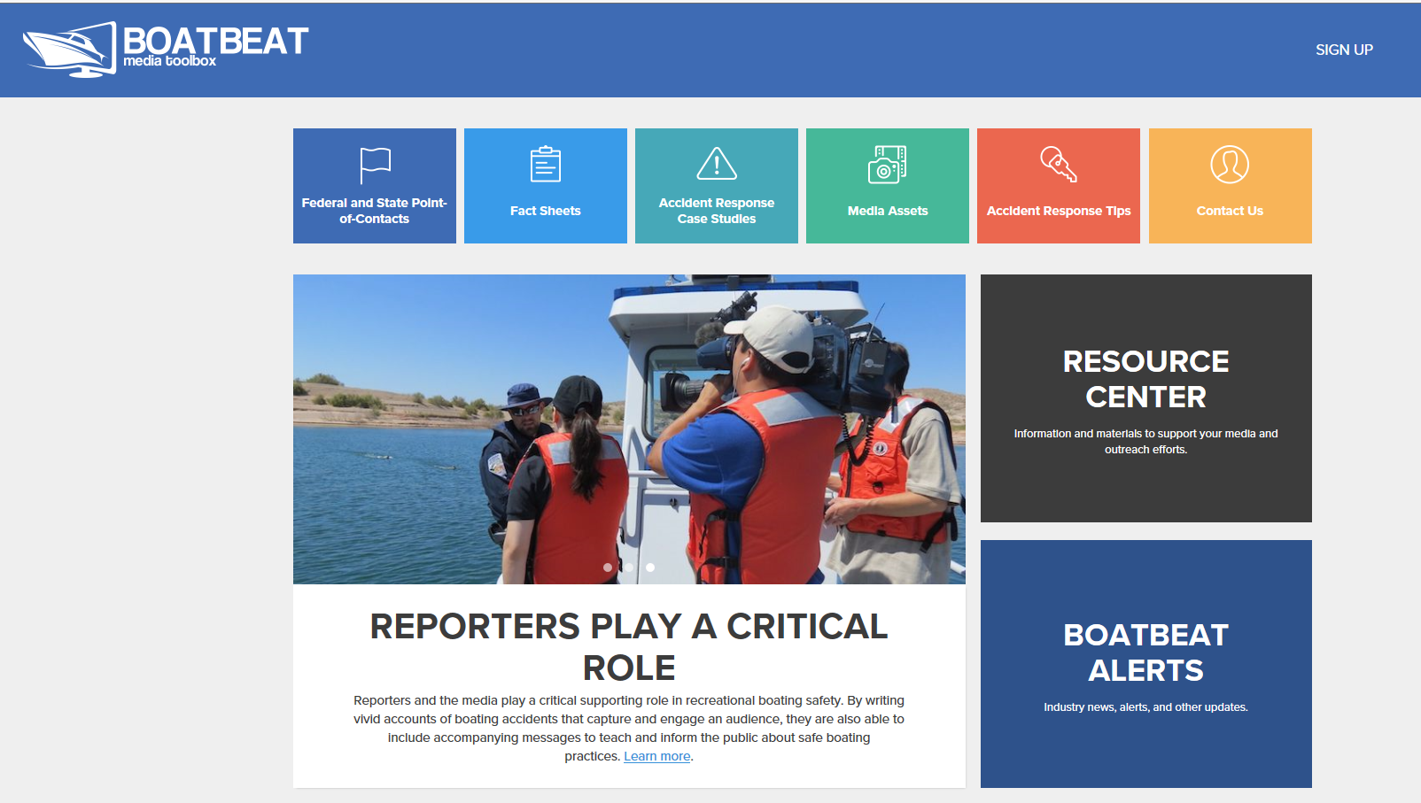
www.boatbeat.org

Slide 7
Scenario
Breaking NEWS! Saturday afternoon, well known agency senior PIO is arrested for OUI, booked into the County Jail, released on bail
Saturday night, all day Sunday, calls come in from all over the state including the Governors Office
Receive an endless parade of phone calls for 48 solid hours
After the story broke, rookie PIO starts to prepare a statement
The Director tells you to hold the statement through weekend

Slide 8
Scenario
Develop a strategy on how to handle the story
Use the BoatBeat website and describe how to utilize it.

Slide 10
Lets discuss your findings Were any of them below?
Reach out to AP and issue a full story to attempt to stop the continued flood of incoming calls
Without being a ghoul about it: Celebrity interactions offer an opportunity
Few people care about issues such as OUI, until someone is killed or someone famous is arrested: Feel good about exploiting the latter
Do treat celebrities with compassion: They are human beings, but we can and should NOT try and protect them from their own actions
Use social media and instant messaging instead of slower forms of communication such as email or phone
Issue a preemptive statement
Conduct extensive follow up with reporters afterwards
Be a resource for the media
Convince DA to make PSA part of plea deal

Slide 11
Lets discuss your findings Were any of them below?
Refer to content before an interview-review BoatBeat
Familiarize yourself with pertinent boating laws including potential penalties-check for Alerts on BoatBeat
Relate stories of similar accidents not involving celebrity
Review Case Studies for suggested topic areas for these sort of cases
Use of “Weasel Words”
What to do when the media gets it wrong
Be a resource for the media with BoatBeat when a story is inaccurate
Do so before or even after a story if it has errors or needs a follow-up.
Share BoatBeat Toolbox content with local media to develop a relationship

Slide 12
Boat Beat Scenario Training NASBLA 2017 Group Results
< 2 Years notes
Agencies policy on OUI
What is an OUI?
What were they operating?
Disclose national stats on OUI
Under investigation-will release more information once investigation is complete
Location of arrest/date/time
Utilize points of contact tab on Boat Beat, use photo from media asset
-for answers regarding release
2-5 Years
State facts: based on arrestee
Who/when/ arrested for…emphasis on-going
General info, state law/fact
Discuss problem, link to national stats
Link to Boat Beat
Contact to state and others

Slide 13
Boat Beat Scenario Training NASBLA 2017 Group Results
5-10 Years
Press release immediately
Focus on general BUI messages using national data-use fact sheet from Boat Beat
State laws-specific to your state
History of OUI in the area
Other safety tips
Stress education
How alcohol/drugs differ and stressors-sun, noise, etc.
> 10 Years
In house OUI stats
State by state penalty
B roll-regionally valid photos
Difference between BWI & OUI
Media talking points-state by state, template

Slide 14
Collaboration with the NASBLA Education committee and all of your organization and MEDIA contacts will help to ensure that we provide you an effective toolbox.
To provide data, facts, links and ideas, contact the National Safe Boating Council directly
Thank you
Contact the National Safe Boating Council at 703-361-4294 or deputy@safeboatingcouncil.org

