Slide 1
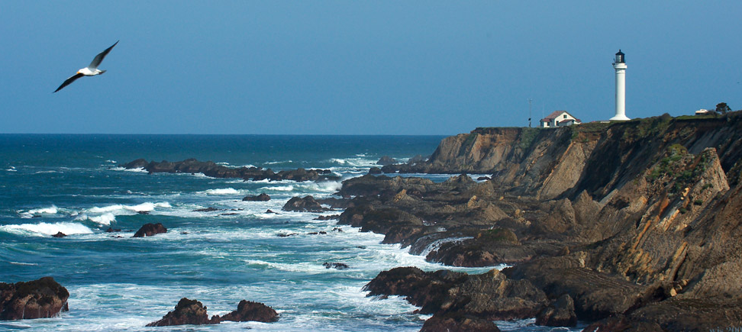
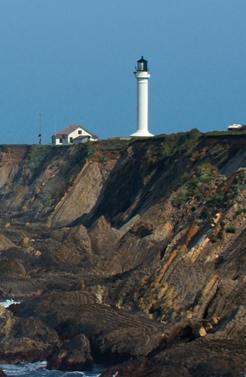
The NASBLA Lighthouse
ERAC’s One-Stop Shop for Your
Boating Data/Analysis Needs
October 19, 2014
NASBLA 55th Annual Conference
Bar Harbor, Maine
Tamara Terry, ERAC Chair, OH
Kris Wahlers, CO
Glenn Moates, TN
Eric Lundin, CT
Notes:
Thanks for joining us today for the official launch of ERAC’s new online forum and resource center aptly named “The NASBLA Lighthouse”… we’ve got some exciting things to share with you, so let’s go ahead and get started…

Slide 2
From a Vision…
A refuge for all of those on a journey
on the high seas of boating safety data…
Providing:
A source for breaking information
A place to go for references, resources and tools
A network of peers and experts to provide guidance and advice
A place to share your successes with others
All available free… online… 24/7…
to anyone and everyone
regardless of their job title
or previous data experience
Notes:
To set the stage for this charge work and the resulting product, you have to go all the way back to 2010, when a group of ERAC members had a unique vision… to develop a refuge for all of those on the often rough seas of boating safety data…
We were looking to establish a safe harbor for our fellow sailors – all of you - where we could:
Provide a source for breaking information
Consolidating important updates and alerts regarding boating safety data and policy issues into one location for ready access
Provide an armory of sorts where all of the references, resources and tools that our crew had gathered, developed, and created over the years could be housed
A one-stop shop when you’re looking for that thing that you know you heard about, but just can’t seem to put your hands on
Develop an interface for communication between peers and various subject matter experts in the area of boating safety data
Providing an opportunity to interact virtually when fiscal realities just won’t allow for face-to-face meetings
And providing you with an opportunity to share your successes
Giving you a forum where you can discuss or post those items that were successful for you – to serve as an inspiration and motivation to others
And if that vision wasn’t lofty enough… this crew wanted to put all of this into a website that is available for free, online, 24 hours a day, 7 days a week and make it available to anyone and everyone – regardless of job title or previous experience in working with boating safety data…

Slide 3
A Lighthouse was Born…
The NASBLA Lighthouse Online Forum
www.nasbla.org/Lighthouse
An interactive online website destination for your data needs
Kris Wahlers, CO – Tour of The NASBLA Lighthouse
Glenn Moates/Eric Lundin/Tammy Terry –
Discussion of additional tools within The NASBLA Lighthouse
Notes:
The result was the “birth” of The NASBLA Lighthouse Online Forum that we’ll be launching with all of you today… an interactive online website destination that – we hope – will answer many of your boating safety data needs…
Kris Wahlers – Charge Leader on the project this year – is going to take us on a tour of the Lighthouse... and then our ERAC Vice Chairs – Glenn Moates from TN and Eric Lundin from CT, in addition to myself, will take a few minutes to share with you some of the other treasures that reside within The Lighthouse…
Kris… the floor is yours…

Slide 4
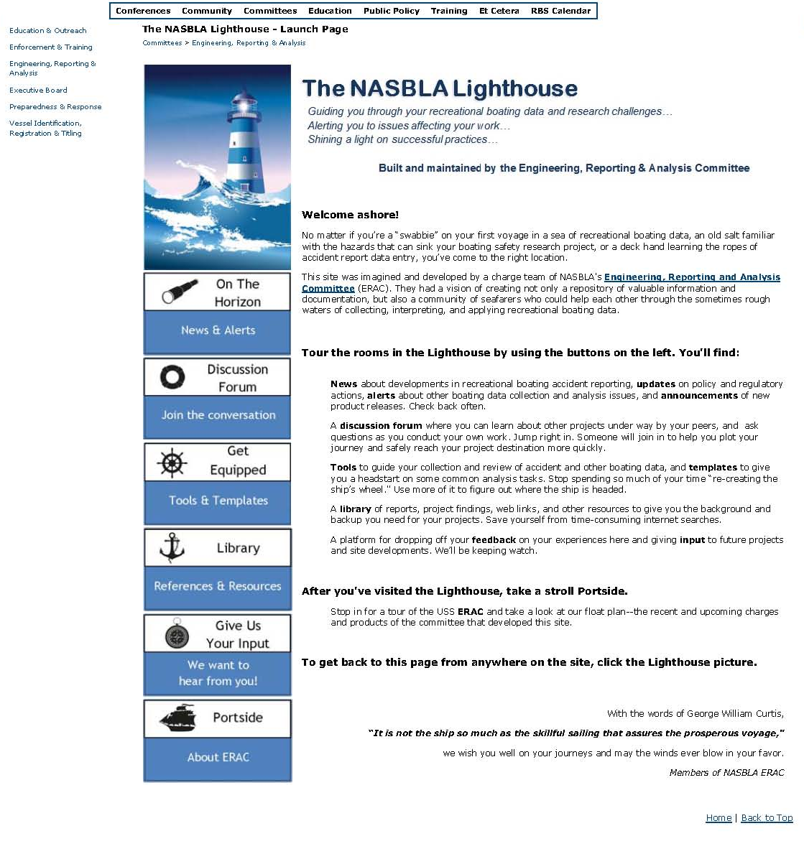
The NASBLA Lighthouse: Landing/Launch Page
Notes:
SLOW DOWN
Thanks
Quick tour of the site
2 sites, front & Community
Ask questions
Encourage to explore more and tell staff
Challenge – targeted at wide range of people
Variety of agency background, research, students
Started with a normal web page outside of Connect to attract people, basic information
Stored in NASBLA site > Community
Search engine key words
The way laid out; go through subpages

Slide 5
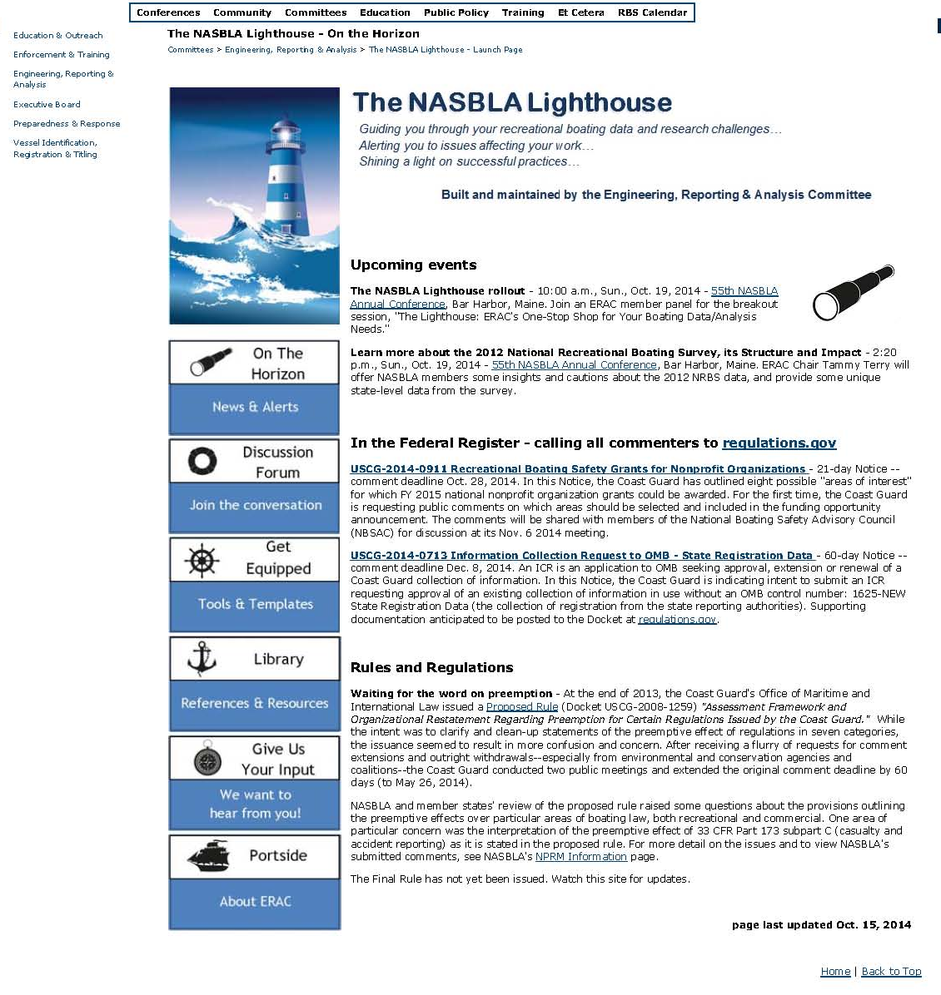
The NASBLA Lighthouse: On the Horizon
Notes:
SLOW DOWN
On the Horizon -
Between state & federal, sometimes can be difficult to keep track of major issues
National scale
Policy & rulemaking – proposed issues (federal register) and updates on pending issues (preemption issue)
Supplement to EZ-ESP
Doesn’t require log in

Slide 6
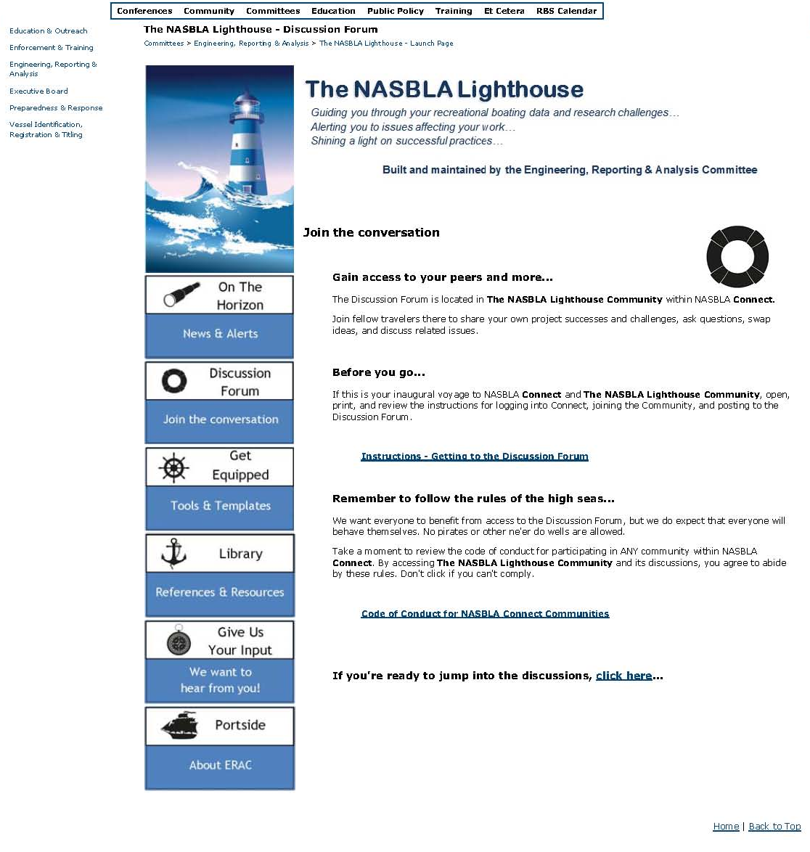
The NASBLA Lighthouse: Discussion Forum
Notes:
SLOW DOWN
Discussion Forum -
Gets into Connect Discussion forum; open communication
Similar to BEAP
Can help people who can’t come to conferences/trainings stay in touch, to stay current
Instructions – not a lot of words, pictures - demonstrate
Code of Conduct – straight from NASBLA, discussion v. library - demonstrate
Link to Community – demonstrate if time

Slide 7
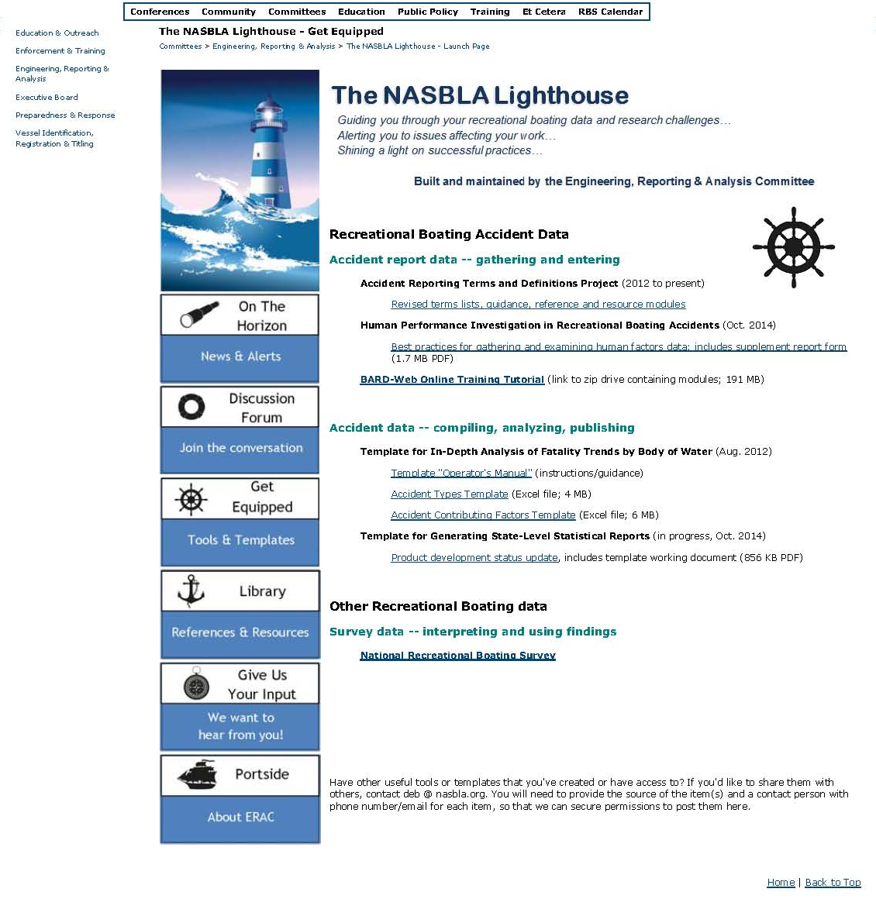
The NASBLA Lighthouse: Getting Equipped
Notes:
SLOW DOWN
Getting Equipped -
A warehouse for projects & products
Committee level material (vs. state & fed.)
Large scale broad here, more specific in library
Doesn't require log in

Slide 8
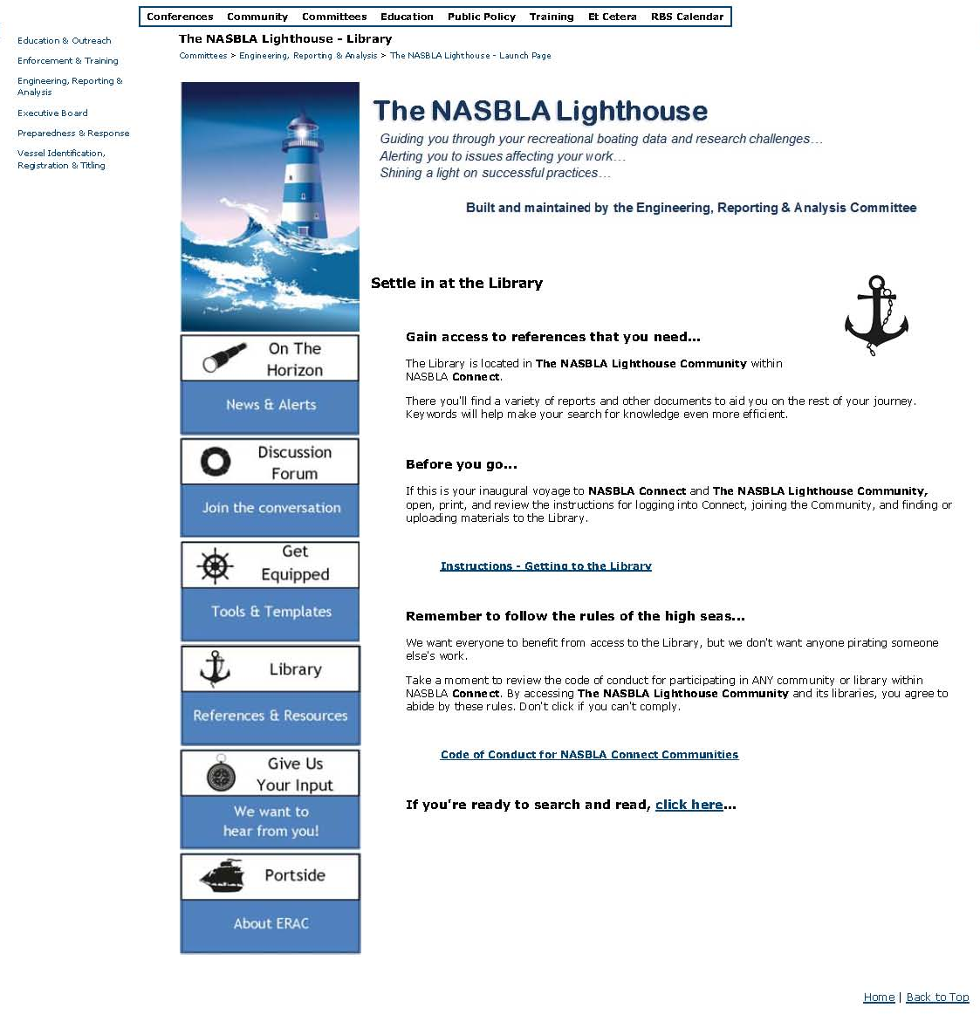
The NASBLA Lighthouse: Library
Notes:
SLOW DOWN
Library -
Also gets into Connect Library;
Library = specific, local, Get Equipped = broad - example
Instructions
Code of Conduct - copyright issues, onus lies with poster
Link to Community

Slide 9
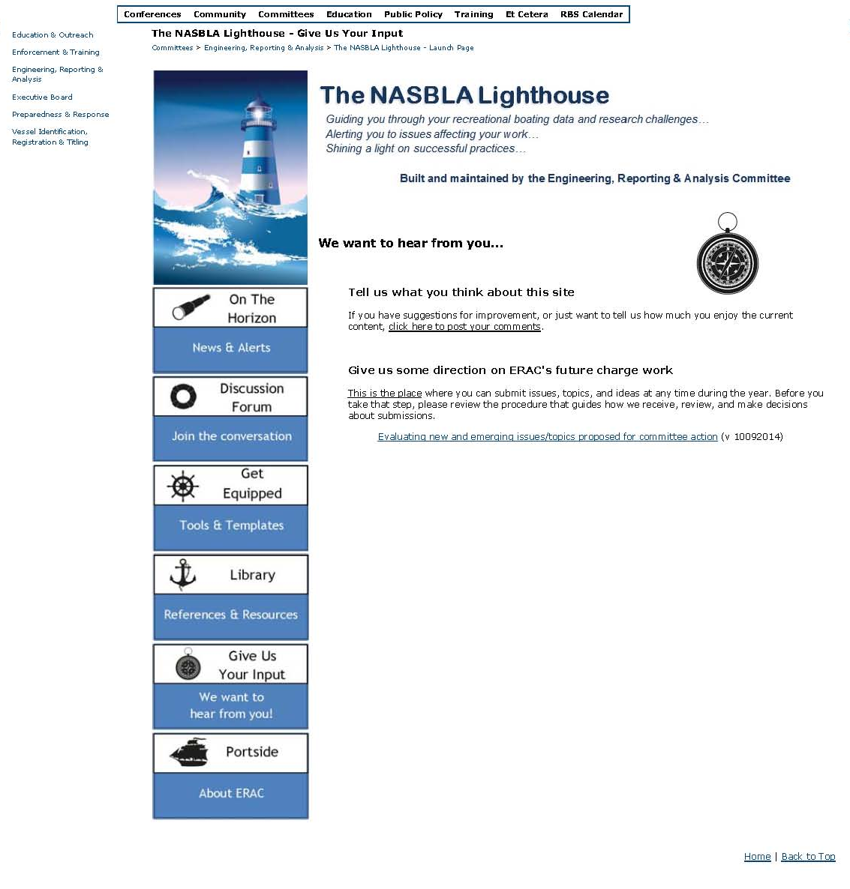
The NASBLA Lighthouse: Give Us Your Input
Notes:
SLOW DOWN
Give Us Your Input -
Future feedback site
Link to moderator e-mail?
Way to report issues on dis. board/library
Gives suggestions for committee focus (D1); in or out of NASBLA

Slide 10
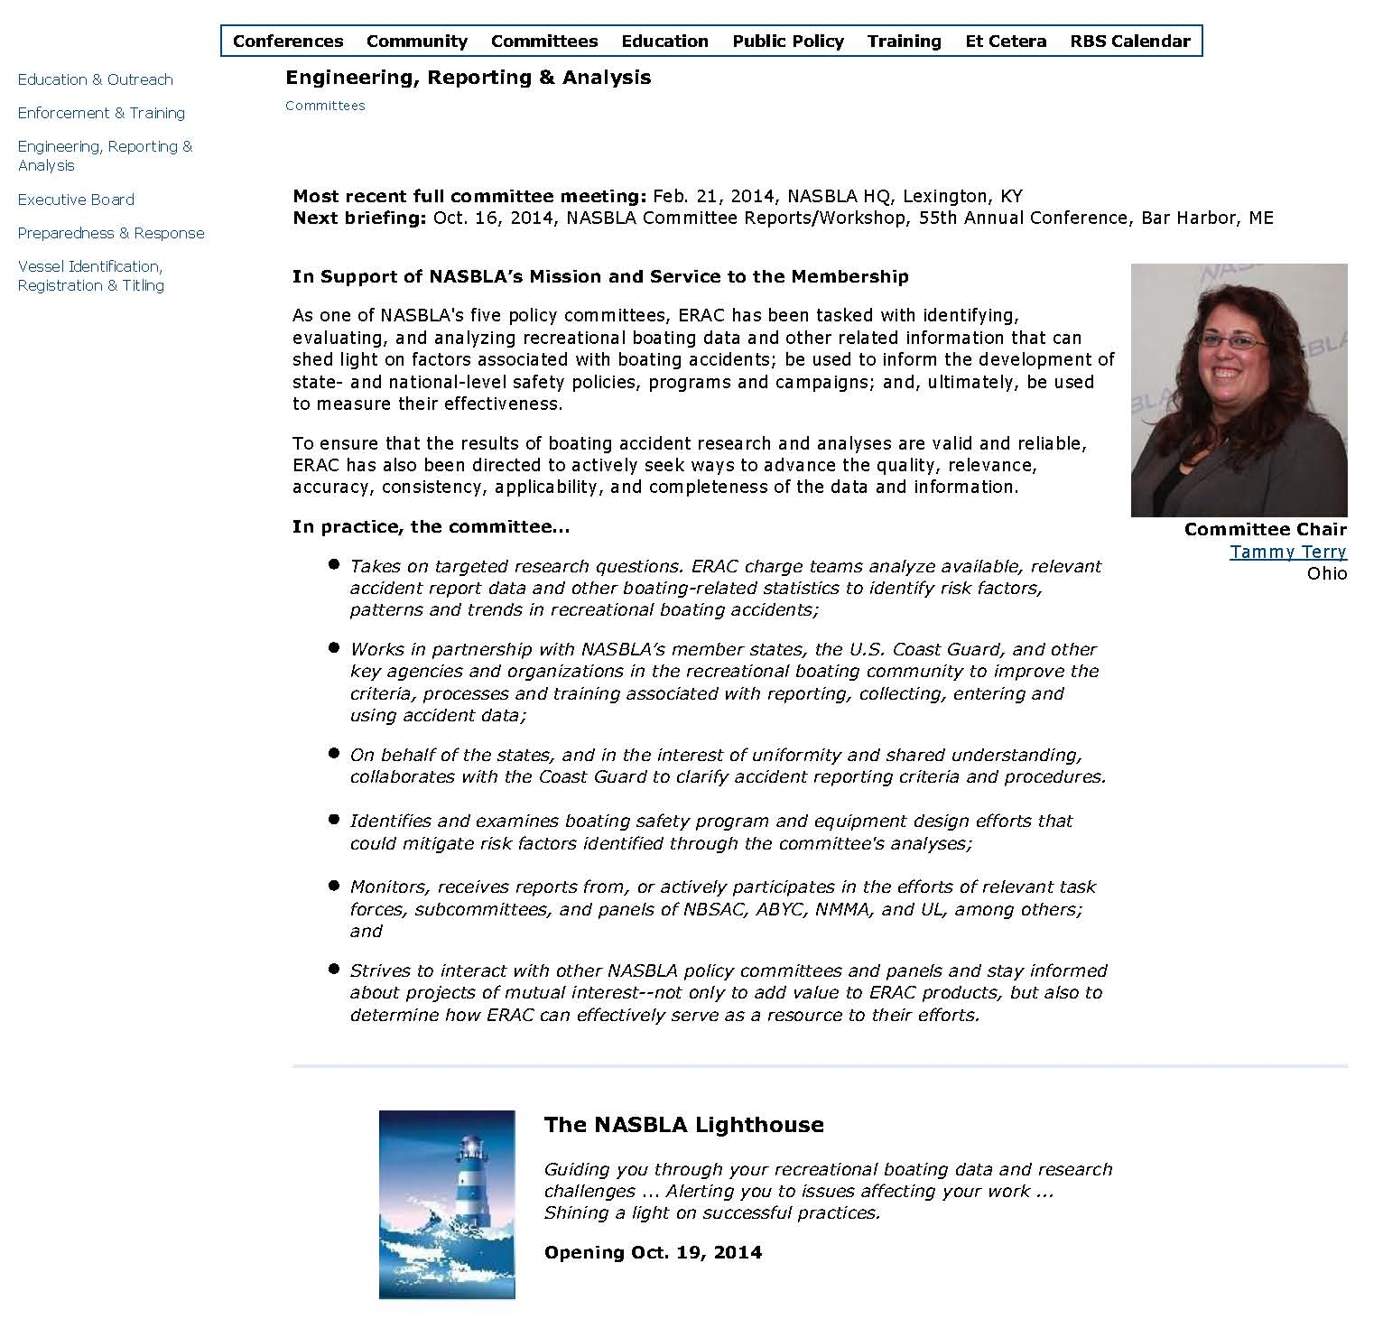
The NASBLA Lighthouse: Portside
Notes:
SLOW DOWN
Portside -
About us page
Specific, details, behind the scenes

Slide 11
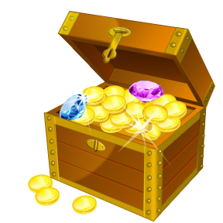
Lighthouse Treasures
Available Now!
Accident Reporting Terms and Definitions Reference and Resource Modules
Human Factors “Best Practices” Instructional Reference w/ Data Collection Tool
BARD-Web Online Training Tutorial
Body of Water Template
Statistical Report Template
National Recreational Boating Survey References and Resources
Coming Soon!
State-by-State Recreational Boating Accident Reporting Guidelines
Electrical Shock Materials
Notes:
Thank you, Kris for that overview…
As Kris mentioned, The NASBLA Lighthouse contains a broad variety of resources, references and tools to assist you in your work… the remainder of our panel here today is going to cover a few of those resources in brief…
Up here you see a variety of materials that are available on the “Getting Equipped” room of The Lighthouse… many of which you have seen presented at prior conferences and in other venues… we want to draw your attention to three “newer” items that have been rolled out this year as well…
We’ll start out with Glenn Moates, one of our two ERAC Vice Chairs this year… Glenn – do you want to get us started with a quick overview of the new Human Factors materials that are now available…

Slide 12
Lighthouse Treasures
Available Now!
Accident Reporting Terms and Definitions Reference and Resource Modules
Human Factors “Best Practices” Instructional Reference w/ Data Collection Tool
BARD-Web Online Training Tutorial
Body of Water Template
Statistical Report Template
National Recreational Boating Survey References and Resources
Coming Soon!
State-by-State Recreational Boating Accident Reporting Guidelines
Electrical Shock Materials
Notes:
Thank you, Glenn…
ERAC is also in the process of developing a Statistical Report Template – we mentioned it at the Committee Briefing on Thursday – that essentially will allow a state to clock a button within BARD and generate a Word document report, auto-populating statistical tables and boilerplate language with accident reporting and possible a few other key details. The state would then be able to “tweak” the wording as needed within the Word document and BOOM – done with the report and ready for distribution.
We see this being helpful to some of you who have never generated a report of this nature in the past – or, even if you do, should make it a little less time consuming…
As I said, the product is still under development, but what you can find on The Lighthouse right now is a list of the items and tables that we are currently considering for inclusion in the template – so what we need from all of you is some feedback and what is already under consideration and some suggestions on other details that we might want to include.
We’ll also continue to post updates so you can stay apprised of the status of this work and have access to the final product as soon as it is available.
Any questions on this particular “treasure”…
OK, then I’m going to hand off the mic to Eric Lundin, our other Vice Chair for ERAC, to discuss some of the ESD materials that will be coming to The Lighthouse soon as well…

Slide 13
Lighthouse Treasures
Available Now!
Accident Reporting Terms and Definitions Reference and Resource Modules
Human Factors “Best Practices” Instructional Reference w/ Data Collection Tool
BARD-Web Online Training Tutorial
Body of Water Template
Statistical Report Template
National Recreational Boating Survey References and Resources
Coming Soon!
State-by-State Recreational Boating Accident Reporting Guidelines
Electrical Shock Materials

Slide 14
Questions?
Visit us at www.nasbla.org/Lighthouse
Notes:
That wraps up our presentation, so let me open the floor to questions…
(If no questions, query the group on what details of The NASBLA Lighthouse most appeal to them and why? Also ask about other details they would like to see included in the future…)
Thank you for your attention – and have a great afternoon!

