Slide 1
Federal Regulations & Regulatory Reform
Richard Moore, Chair, NBSAC Regulatory Reform Subcommittee
Jeff Ludwig, Regulatory Development Manager, USCG

Slide 2
USCG HQ’s Regulatory Development Process
Regulatory Reform/Review Initiatives

Slide 3
Congress

Slide 4
Good Idea Fairy

Slide 5
Legal
Administrative Procedure Act
Notice and Comment
Federal Register
Regulations.gov – online docket
46 USC 43, 61, 123 & 131
NBSAC – USCG required to consult NBSAC on potential regulations

Slide 6
NBSAC
National Boating Safety Advisory Council
Required to be consulted on potential regs:
establishing minimum safety standards for recreational vessels and associated equipment
requiring the installation, carrying, or use of associated equipment
requiring or permitting the display of seals, labels, plates, insignia, or other devices for certifying or evidencing compliance with safety regulations
And major boating safety matters related chapter 131 (state boating safety programs)

Slide 7
NBSAC
21 Members
7 reps of State officials responsible for State boating safety programs;
7 reps of rec vessel manufacturers & associated equip manufacturers; and
7 reps of national rec boating orgs & from the general public, at least 5 of whom shall be reps of national rec boating orgs
Members serve three year terms; typically meets twice a year
USCG pays member travel expenses
https://homeport.uscg.mil/NBSAC

Slide 8
Policy
USCG Regulatory Development
COMDTINST M16703 (Series)
Office of Management & Budget (OMB)
EO 12866 – Regulatory Planning & Review
Economically Significant (> $100m)
“Other” Significant
Affects budget
Novel policy
Conflicts w/ other agency

Slide 9
Policy
New Administration Regulatory Priorities:
EO 13771 (Reducing Regulation and Controlling Regulatory Costs)
2 for 1
EO 13777 (Enforcing the Regulatory Reform Agenda) Reviewing existing regulations for obsolete
eliminate jobs, or inhibit job creation;
are outdated, unnecessary, or ineffective;
impose costs that exceed benefits;

Slide 10
Proposal
Sponsor office develops a project proposal for consideration by the Marine Safety & Security Council (MSSC)
MSSC is the Commandant’s advisory body for regulatory initiatives, the council approves all new rulemaking projects
The proposal is basically an executive summary, with the policy fairly developed and alternatives presented/discussed

Slide 11
Development Process
Assuming MSSC Approval
APA kicks in and project team assigned
Project Manager
Subject Matter Expert (SME)
Economist
Attorney
Technical Writer

Slide 12
Development Process
Regulatory Documents drafted
Multiple levels of review
If non-significant (<$100m) DHS
If significant OMB
Rulemaking document published for public comment – usually 90 days in USCG
Comments reviewed, addressed and final agency action taken

Slide 13
Regulatory Review
Public Comment
https://www.nasbla.org/nasblamain/advocacy/policy/fedreg/cgregs
Comment period closes today at midnight!!
http://www.regulations.gov
docket # USCG-2017-0480
Advisory Committeee Review
NBSAC Regulatory Review Subcommittee
Richard Moore and John Johnson
Program Review

Slide 14
Sections of Regulation Under Review

Slide 15
Subcommittee Calls
NBSAC Reg Review Subcommittee has held 4 calls to date:
Initial discussions on 33 CFR 173/4 (accident reporting); 33 CFR 173/174 (numbering); 33 CFR 177; 33 CFR 187
Future calls on 33 CFR 179/181/183 and 33 CFR 175
Information available at:
https://homeport.uscg.mil/NBSAC - look for regulatory review subcommittee in “Announcements” section at top of page

Slide 16
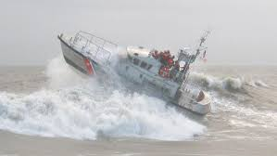
33 CFR 177
Correction of Especially Hazardous Conditions

Slide 17
33 CFR 187
Vessel Identification System (VIS)

Slide 18
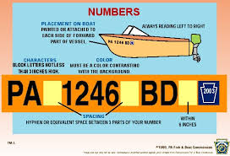
33 CFR 173/174
Vessel Numbering
State Numbering Systems

Slide 19
33 CFR 179/181/183
Defect Notification
Manufacturer Requirements
Boats & Associated Equipment

Slide 20
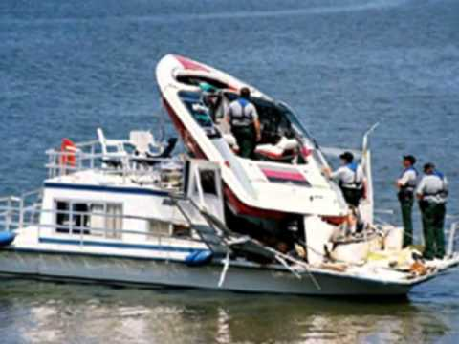
33 CFR 173/174
Casualty & Accident Reporting
State Casualty Reporting Systems

Slide 21
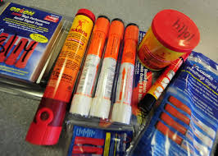
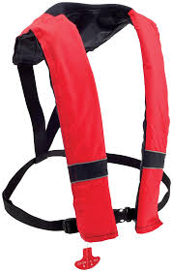
33 CFR 175
Equipment Requirements

Slide 22
Your questions and thoughts
22

