Slide 1
United States Coast Guard
Eighth District
PFD Rule Update
What Happened With
Life Jacket Type Rating?
Ed Huntsman, USCG

Slide 2
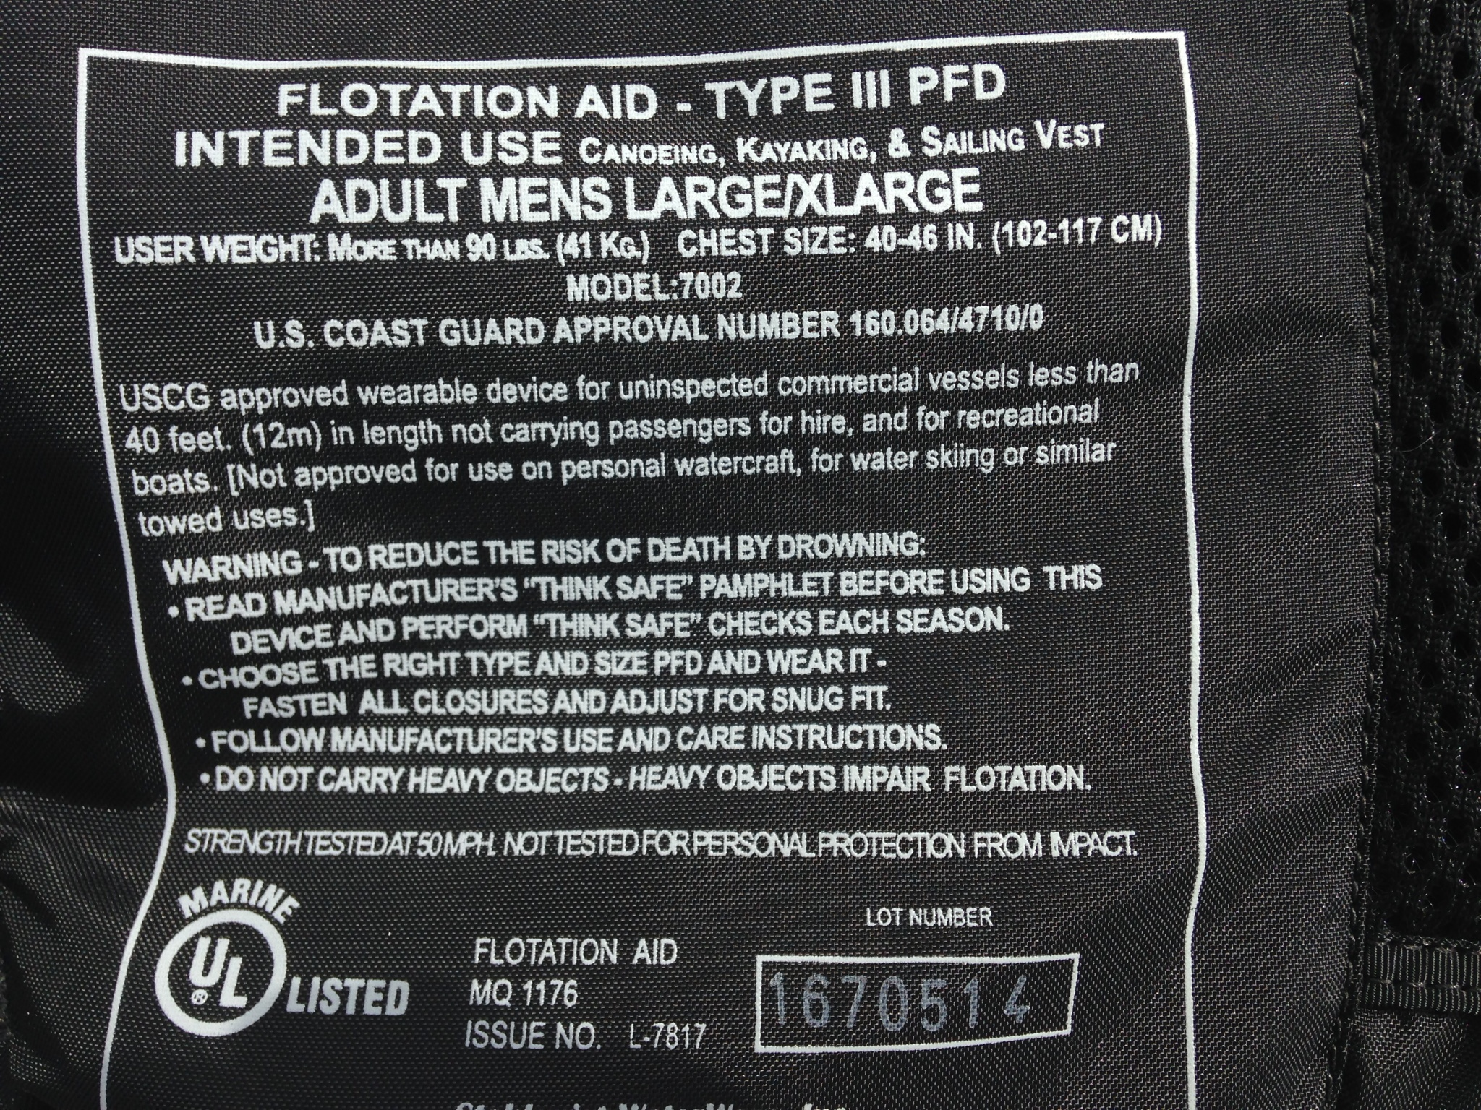
United States Coast Guard
Eighth District

Slide 3
United States Coast Guard
Eighth District
Life Jacket (PFD) Type Codes
The Coast Guard issued a Rule on October 22, 2014 removing references to Type codes In regulations on the carriage and labeling of Coast Guard-approved personal flotation devices (PFDs).

Slide 4
United States Coast Guard
Eighth District
PFD Type Code Change
This rule change affects:
Federal regulations
Commercial operators
Recreational boaters
Here’s an overview of the change . . .

Slide 5
United States Coast Guard
Eighth District
PFD Type Code Change
Public Rule Making Comment Process:
NPRM (78 FR 49412): August 14, 2013
NRPM Comment Period Ended on October 15, 2013
Final Rule announced July, 2014
Rule in Affect October 22, 2014

Slide 6
United States Coast Guard
Eighth District
PFD Type Code Change
The rule change removed references to longstanding PFD type codes from regulations for the carriage and marking of Coast Guard-approved PFDs.

Slide 7
United States Coast Guard
Eighth District
PFD Type Code Change
NOTHING HAS
CHANGED YET, BUT IT WILL!

Slide 8
United States Coast Guard
Eighth District
PFD Type Code Change
Removing type codes from regulations will facilitate future incorporation by reference of new industry consensus standards for
PFD labeling that more effectively convey safety information, and is a step toward harmonization of regulations with PFD requirements in Canada and other countries.

Slide 9
United States Coast Guard
Eighth District
Regulations affected . . .
Among others:
33 CFR 175 – Equipment Requirements and 181 – Personal Flotation Devices
Title 46 Part 160 – Lifesaving Equipment

Slide 10
United States Coast Guard
Eighth District
PFD Type Code Change
We will see icons that transcend written information!
English
French
Spanish and others?

Slide 11
United States Coast Guard
Eighth District
PFD Type Code Change
European Union (EU) Examples:

Slide 12
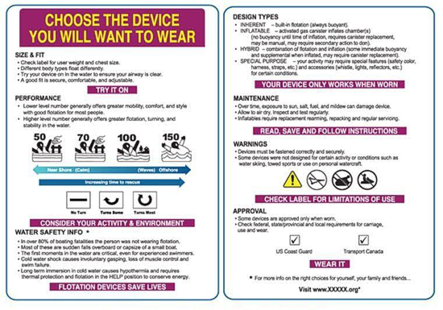
United States Coast Guard
Eighth District
Actual new brochure (tag) Attached to new life jacket:

Slide 13
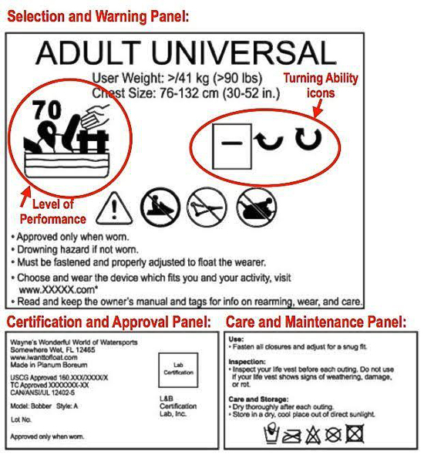
United States Coast Guard
Eighth District

Slide 14
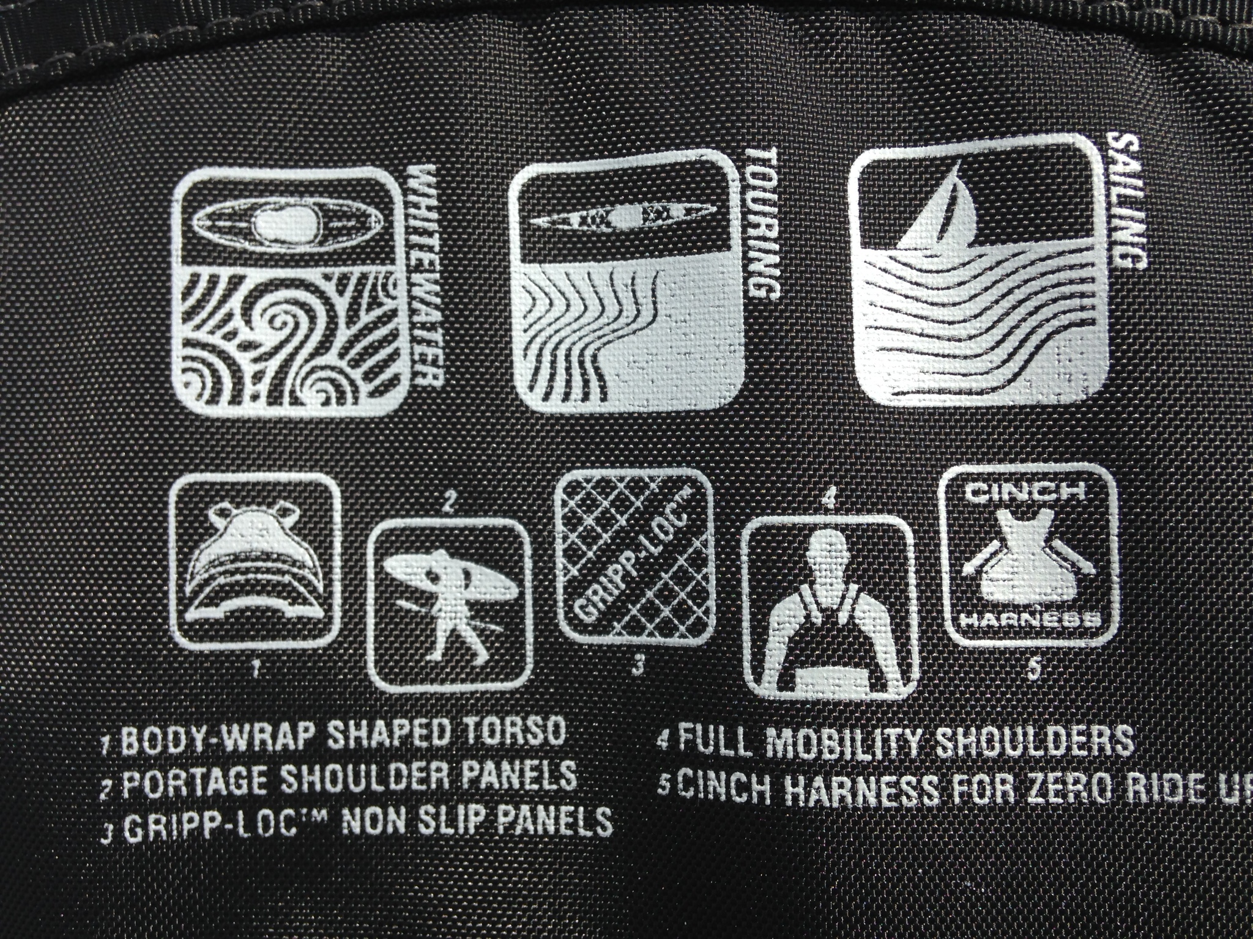
United States Coast Guard
Eighth District
Symbols already showing up by some manufacturers

Slide 15
United States Coast Guard
Eighth District
Remember, nothing has changed yet!
But it is coming . . .

Slide 16
United States Coast Guard
Eighth District
U.L. Standards Technical Panel
Meeting at CG HQs April 10-13.
Drafting standards for both U.S. and Canada.
Full PFD Standards Technical Panel meeting at the end of May, 2018 to discuss progress.
For more information contact the Coast Guard’s Lifesaving and Fire Safety Division.
Hope to learn more at the Life Jacket Assoc. (formerly PFDMA) meeting in June, 2018.

Slide 17
United States Coast Guard
Eighth District
Questions?
Comments?
Edward.L.Huntsman@uscg.mil
504-671-2148

