Slide 1
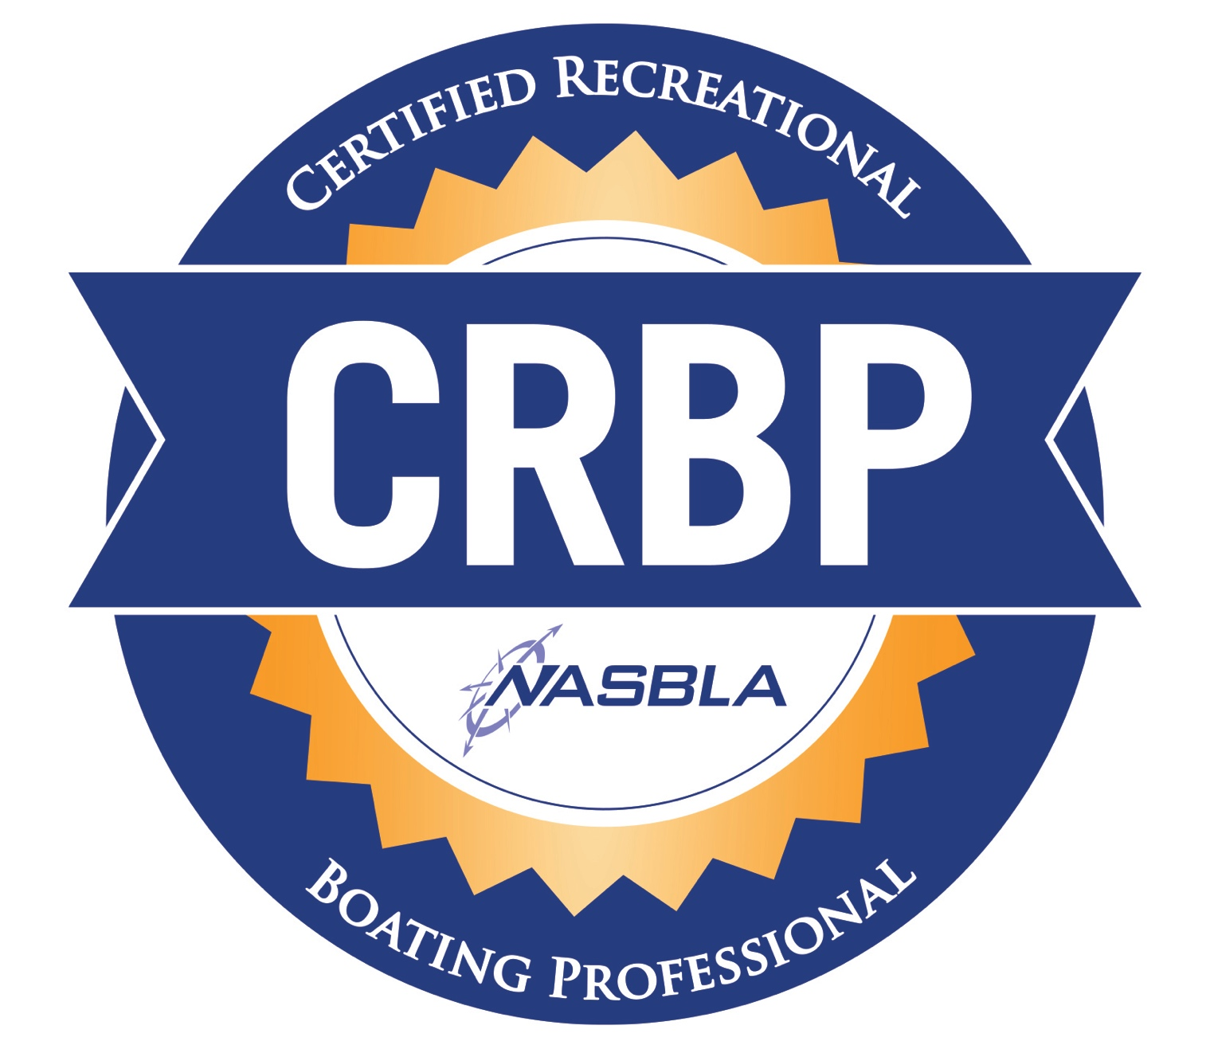
It’s YOUR career…THEIR lives…OUR future!
John Malatak
Rapid City, SD
September 13, 2017

Slide 2
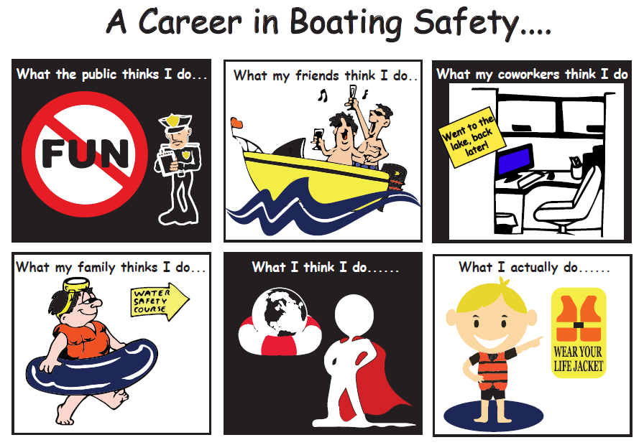
The Truth Behind YOUR Career…
Graphic courtesy of Kansas Dept. of Wildlife & Parks

Slide 3
Today’s Mission:
General Background and Development
Current State and Rationale Why to Develop a Certification/Credentialing Program
Program Elements, Goals, and Objectives
Why Become a “CRBP”; Value of Program; Program Launch & “Teaser” Exam
Next Steps & General Discussion

Slide 4
Why Develop a Certification Program
Ensure Professional Competency
Provide a Defined Professional Development Path
Enhance the Prestige of those Working in the Recreational Boating Field
Recognize professionals (paid & volunteer) qualified by a combination of education and experience, adherence to high standards of integrity, and an assessed commitment to lifelong learning and professional development.

Slide 5
Desired Outcomes of the Program
Build professional competency and future leaders.
Train and position the next generation of professionals to replace retiring professionals
NASBLA has a vested interest in committed, trained an certified professionals
Credential benefits ALL, as well as ‘end customer’ – the recreational boater.
Develop leaders that can see over the walls and overcome career obstacles that may prohibit the growth of the national RBS Program.

Slide 6
2016 BLA Census
September 2016

Slide 7
Commission Members
John Adey Boating Industry (ABYC)
Laurel Anders States (PA)
Robert Brandenstein Non-Profit (USPS)
Mark Brown States (OK)
Ed Carter State Agency Head (TN)
Virgil Chambers* Non-Profit (NSBC), retired
Michael Cortese Federal (USCG)
Dan Hesket States (KS)
Stan Linnell States (MN)
Eric Lundin States (CT)
Ed Lyngar* States (NV)
Gary Owen Non-Profit (NWSC)
Bruce Rowe Boating Industry (Forever Resorts)
Kelli Toth States (AK)
Rachel Zechenelly States (LA)
Red indicates current member

Slide 8
The Professional Designation - CRBP
The Certified Recreational Boating Professional (CRBP) certification is a voluntary credential for recreational boating professionals offered by NASBLA
The credential is broad-based and addresses boating professionals’ knowledge, performance and career achievements in the identified program domains and encompasses the boating program.
Individuals who wish to pursue the credential must be participating in the RBS Program and pass various examinations and evaluation processes.
Those who achieve success earn the right to display the CRBP designation after their name.

Slide 9
PROGRAM DOMAINS
Management, Leadership, Ethics and Character [5]
Boating Law Administration [4]
Boating Laws and Compliance [6]
Federal Programs [4]
Partnerships [6]
Boating Safety Marketing Outreach and Public Relations [8]
Boating Safety Education [7]
Boating Safety Training and Program Development [5]
Waterways Management and Access [9]
Vessel Numbering, Titling and Vessel Identification (VIS) [5]
10 Program Domains
59 Program Elements

Slide 10
CRBP Domains

Slide 11
Program Value
Credential is the ‘de facto’ evidence of knowledge, experience and competence.
Those who hold the certification will be sought out for leadership positions in government, nonprofit and for-profit recreational boating agencies and organizations.
Candidates for jobs or advancement opportunities in recreational boating will greatly benefit by hold the designation.
Goal is to “brand” CRBP as the preeminent professional recognition for anyone working in recreational boating

Slide 12
ICE and NCCA
ICE is a leading developer of standards for both certification and certificate programs, test development and assessment-based certificate programs.
National Commission for Certifying Agencies (NCCA) provides validation that programs have met recognized national and international credentialing industry standards certification programs.

Slide 13
Desired Outcomes for Program Participants
Designation is not the end but is the access to lifelong professional development and recognition.
Those that achieve the credential will have demonstrated competence and professional growth through:
Continuing Education
Involvement
Leadership

Slide 14
Waypoints to your CRBP
Offered at three levels (after paying one time $50 application fee): - RBP Level 1: three (3) domains (3 of 10), plus related CRBP requirements like CEUs - RBP Level 2: three (3) additional domains (6 of 10), plus related requirements - CRBP: completion of four remaining domain exams, or take a comprehensive exam covering all ten (10) domains

Slide 15
Program Administrative Elements
Continuing (CEUs) = 50 hours (over last 5 years)
Application fee = $50
Domain examination fee = $25/domain exam - i.e. minimum payment to attain RBP Level 1 = $125 ($50 application fee, $25 ea. for three domain examinations)
Must have minimum of three (3) years experience in a related field
CRBP designation, as well as RBP Levels 1&2 current for three-year period from date the designation is conferred (shirtly after successful completion of exam)
CRBP credentials (RBP1, RBP2 and CRBP) may be renewed upon submission of a renewal fee (CRBP=$125, RBP2=$100 and RBP1=$75) and evidence of CEUs (30 hrs)

Slide 16
General Information
Domain examinations do not have to be taken in numerical order
Candidate seated examination options (if successfully completed) are: - 3 domains = RBP Level1 - 6 domains = RBP Level2 - 10 domains – Certified Recreational Boating Professional (CRBP)
Candidates must successfully pass the number of domain examinations attempted to receive that level of credentialing (i.e. if attempt to take 6, but only pass 4 – RBP Level 1 would not be issued as a ’consolation’ credential)

Slide 17
Participating with Poll Everywhere
Pollev.com/NASBLA
22333
NASBLA
<your response>
Web voting
Text voting
Notes:
General use graphics to be customized according to your poll’s instructions

Slide 18
Notes:
Which of the following best describes leadership?
https://www.polleverywhere.com/multiple_choice_polls/Pm8YlDpg8GGvvww

Slide 19
Notes:
What part of a state application for federal boating safety grant funds details the program activities of a state?
https://www.polleverywhere.com/multiple_choice_polls/x4uCIASy4WstT0e

Slide 20
Notes:
The validated battery of Seated Field Sobriety Tests used in a Boating Under the Influence Investigation consists of:
https://www.polleverywhere.com/multiple_choice_polls/4gaSwjyvABn6wbE

Slide 21
Notes:
What is the name of the federal law that provides money for the Coast Guard to distribute to the states, territories and boating safety grant applicants?
https://www.polleverywhere.com/multiple_choice_polls/8JJf3QjBj5lYG5t

Slide 22
Notes:
There is a user conflict issue on a large popular river involving paddlers and personal watercraft operation. What two primary groups could be used as the best resource to discuss the concern?
https://www.polleverywhere.com/multiple_choice_polls/OO2mBnFaiWW6VdP

Slide 23
Notes:
In a crisis situation, what is the role of an upper management spokesperson?
https://www.polleverywhere.com/multiple_choice_polls/ZSPHNQSVorLALD5

Slide 24
Notes:
A professional association (such as NASBLA) is formally recognizing organizations that provide training and education in the profession that it represents. Which of the follow options best describes the activity?
https://www.polleverywhere.com/multiple_choice_polls/WsJnsCItQ9cqjxU

Slide 25
Notes:
What are the three Es to the public health approach to injury prevention?
https://www.polleverywhere.com/multiple_choice_polls/7tC78hsEAGQUDx2

Slide 26
Notes:
A city wishes to initiate a water surface use ordinance for a lake located within its boundaries. One of the most effective methods to gather public input is to:
https://www.polleverywhere.com/multiple_choice_polls/JXj7862TywFeMoi

Slide 27
Notes:
State of principle operation means:
https://www.polleverywhere.com/multiple_choice_polls/pAjTr4ynJpz830Q

Slide 28
Questions? Comments?
John Malatak
Program Mgr.
RBS Professional Certification
NASBLA Headquarters
859.225.9487 ext. 7373

