Slide 1
Advancing Boater Education and Training: The ‘Spring Aboard’ National Boater Education Campaign
(Including Skill-Program Conformity Assessment and Evaluation Phase II)
Notes:
NOTE:
To change the image on this slide, select the picture and delete it. Then click the Pictures icon in the placeholder to insert your own image.

Slide 2
Advance National Campaigns
E&O_M&O_2017-1
Knowledge and awareness of safe boating practices is a first step of being a safe boater. The more people who complete a course, the more chance they will follow safe boating practices.
Notes:
A more extensive report will be provided on Thursday at the BLA workshop.

Slide 4
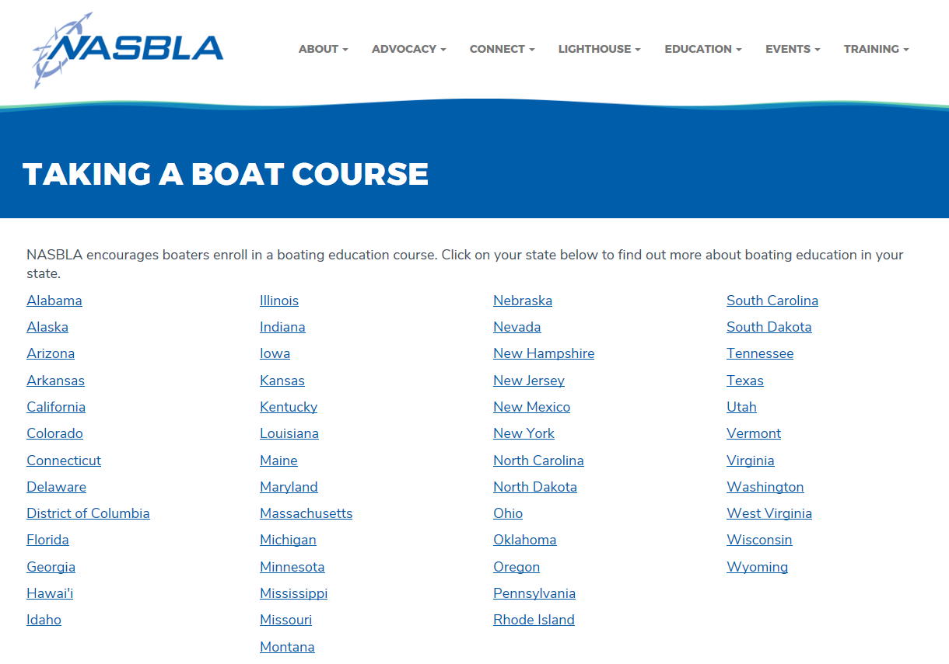
Webinars! Facebook Page! Twitter Feeds! Course Provider Incentives! Links to all state courses!

Slide 5
Spring Aboard/ Conformity Assessment includes…
Development and implementation of a “Verified Course” mark and conformity assessment process for power, sail, or human-propelled skills courses.

Slide 6
How can we get more people enrolled in boater education courses through the efforts of this National Campaign??

Slide 7
Items for Discussion
Logo and Branding
“Spring Aboard”
Logo Design
Dates
Range
Process – Participant Registration, etc.
Reporting
Follow up Survey
Metrics
Other? – Your Ideas, Concerns, Input

Slide 8
Items for Discussion
Logo and Branding
“Spring Aboard”
Logo Design
Dates
Range
Process – Participant Registration, etc.
Reporting
Follow up Survey
Metrics
Other – Your Ideas, Your Concerns
Express Your Opinion
Green Cards – Yes, Agree
Red Card – No, Disagree
Yellow Card – Not Sure, Neutral

Slide 9
Who is the Target Audience?
Males – Approx. 45 years of age?
All Boaters?
Youth?
Only those mandated?
Different from state to state?
Powerboat Operators?
New boaters?

Slide 10
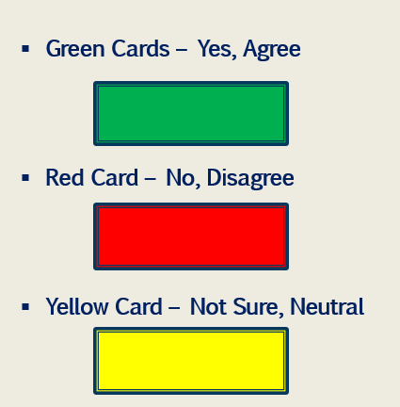
Logo and Branding
Logo and Branding
“Spring Aboard”
Logo Design

Slide 11
Logo and Branding
Logo and Branding
“Spring Aboard”
Logo Design

Slide 12
Logo and Branding
Logo and Branding
“Spring Aboard”
Logo Design

Slide 13
DATES
Spring Equinox
MARCH 18-24, 2018
“No Date” Logo Option remains available

Slide 14
DATES
Process
Participant Registration, etc.

Slide 15
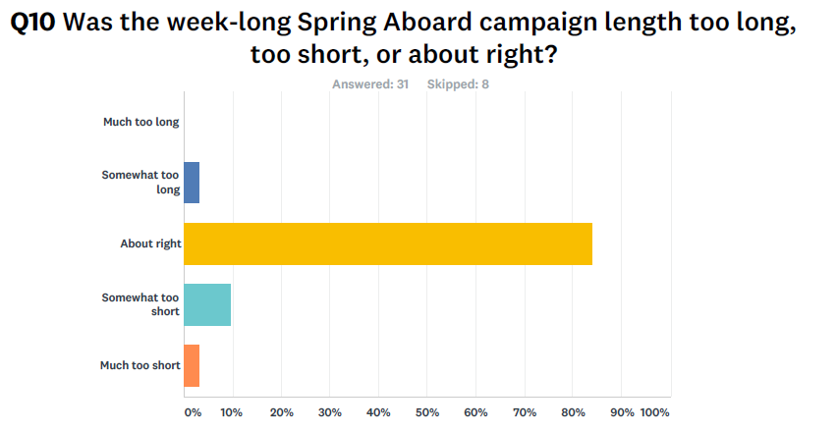
Reporting
Survey
States
Registered Participants
Course Providers
When??

Slide 16
Reporting
Survey
States
Registered Participants
Course Providers
When??
Two weeks after event
One month after event
Six weeks after event
Two of more months after event

Slide 17
Other Topics? Ideas? Comments?
Social Media?
Media outreach?
Dedicated article?

Slide 18
THANK YOU!
For information, contact:
Pamela Dillon, NASBLA Education and Standards Director
pam@nasbla.org

